Slide 1




SASI KISHORE VARMA
JANUARY 10, 2025
Customer Analytics
Marketing Modeling

Slide 2
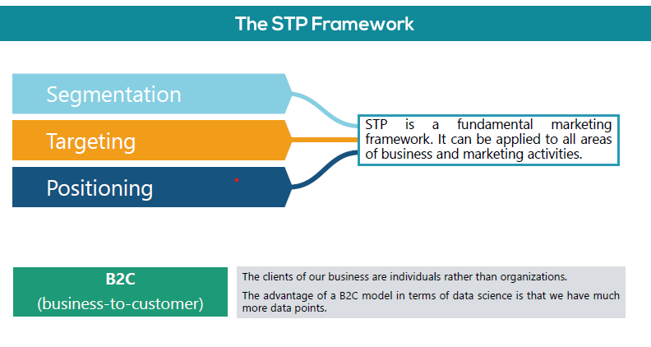
PAGE 2

Slide 3
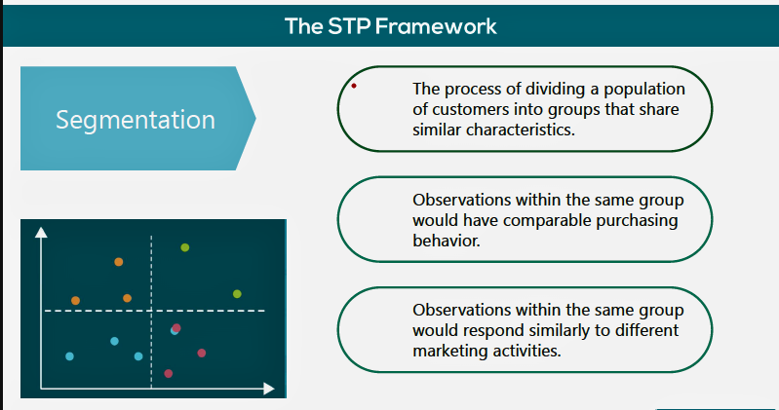
PAGE 3

Slide 4
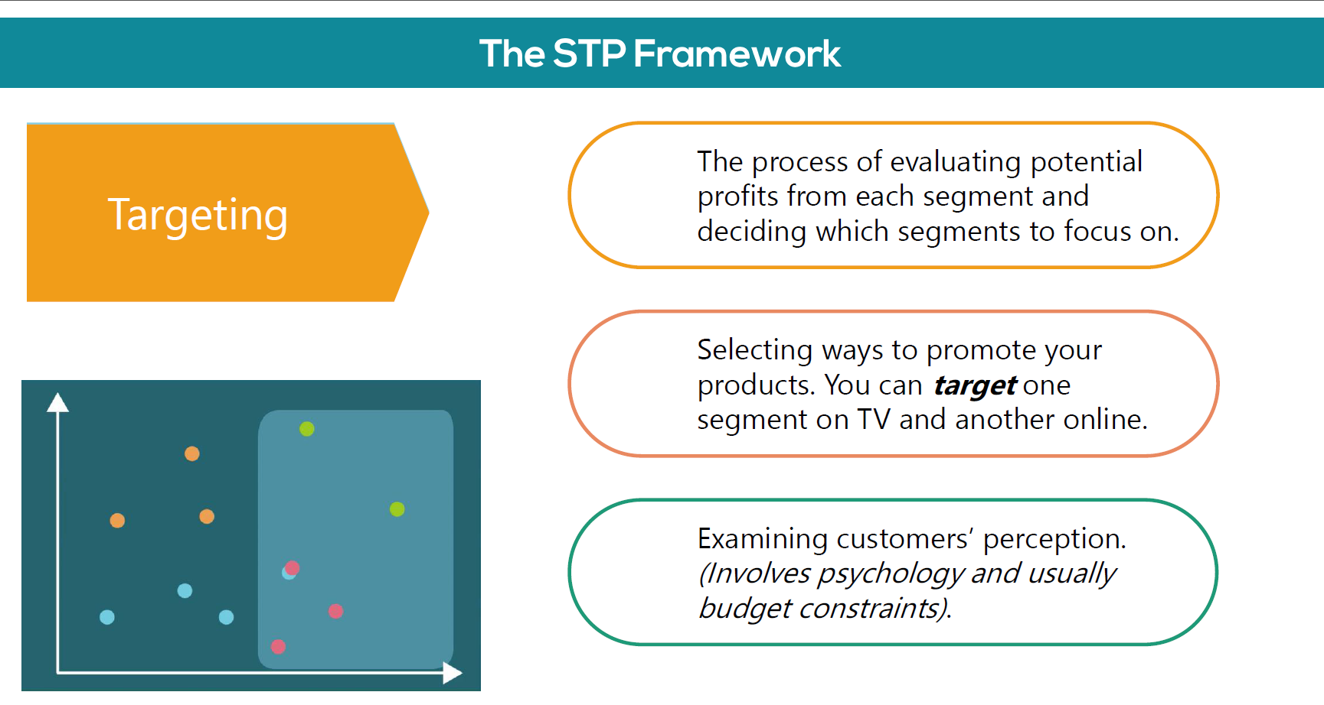
PAGE 4

Slide 5
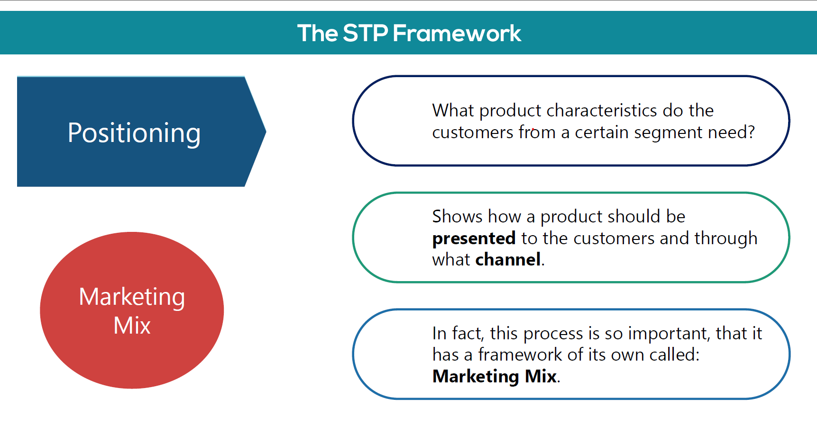

PAGE 5
BACK TO AGENDA PAGE

Slide 6
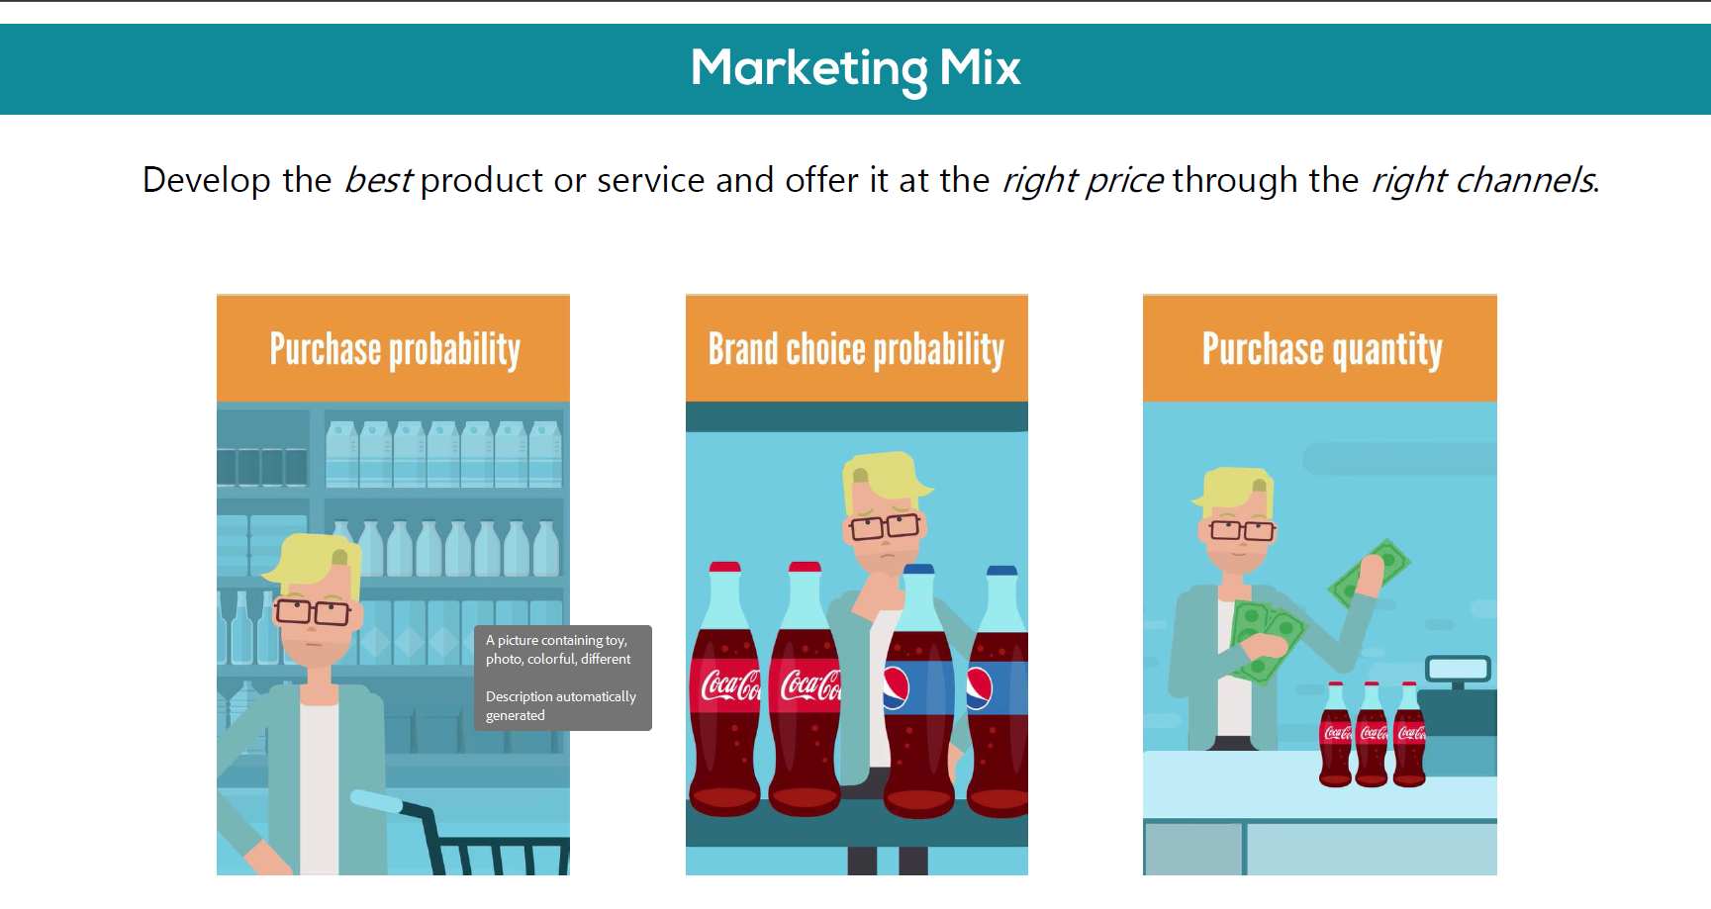
PAGE 6

Slide 7
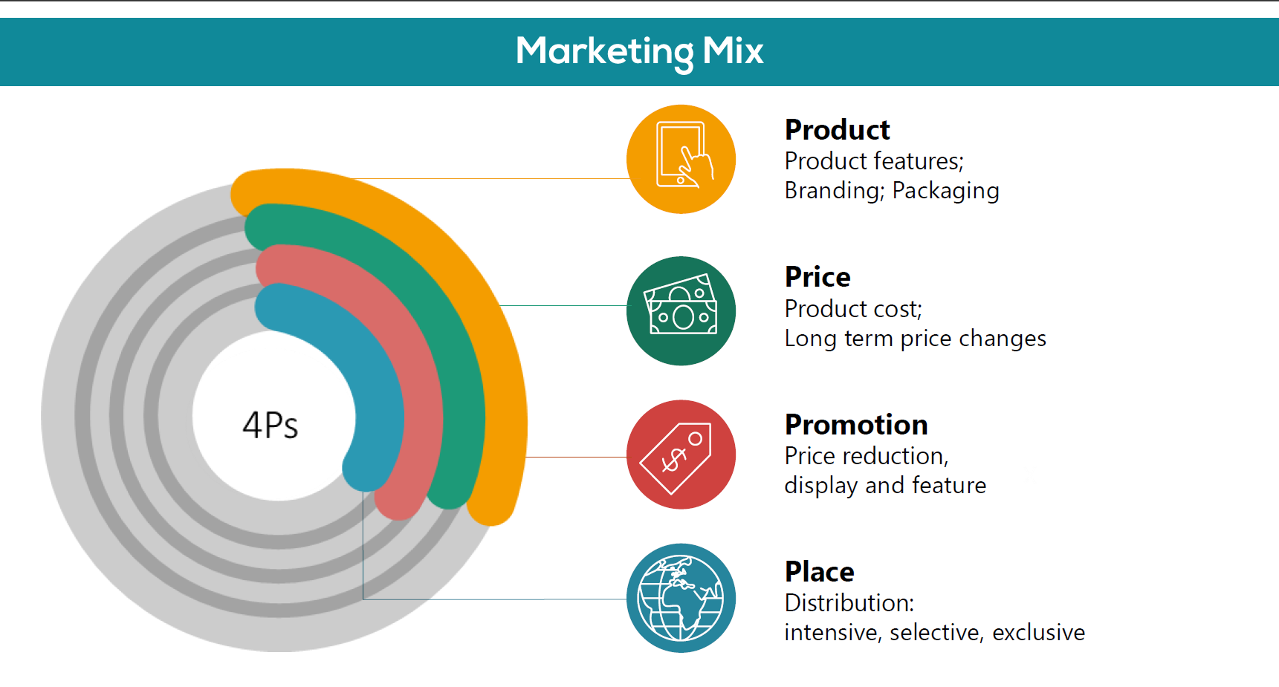
PAGE 7

Slide 8
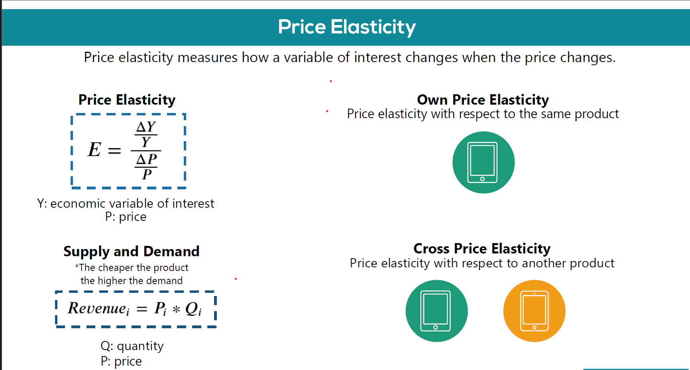
PAGE 8

Slide 9
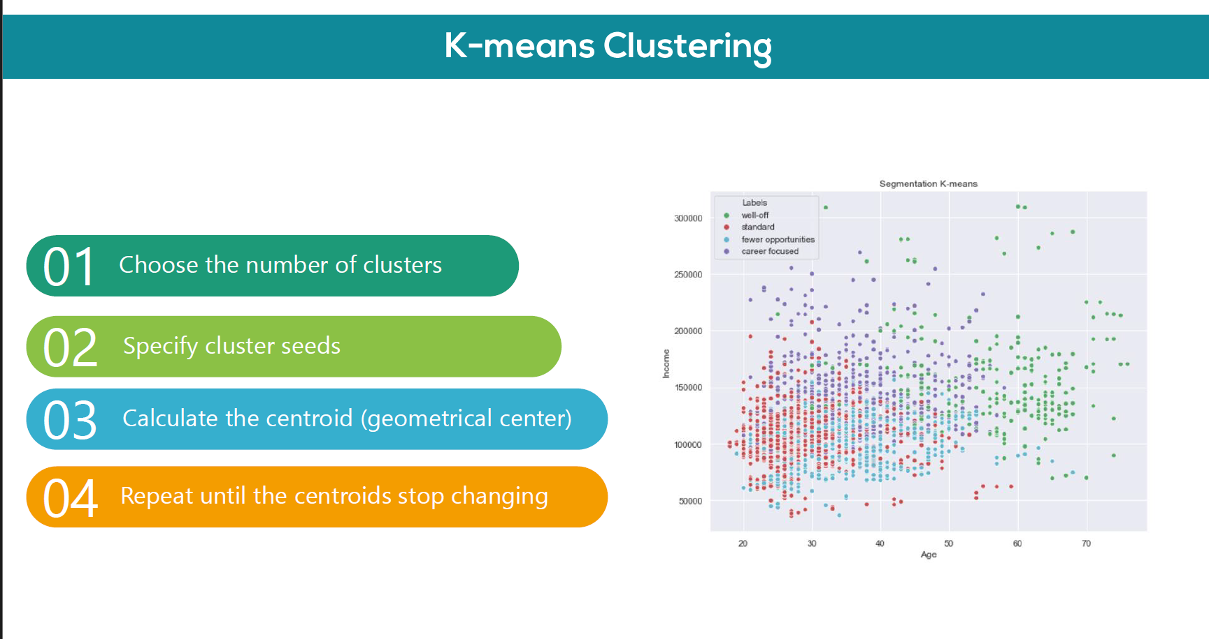
PAGE 9

Slide 10
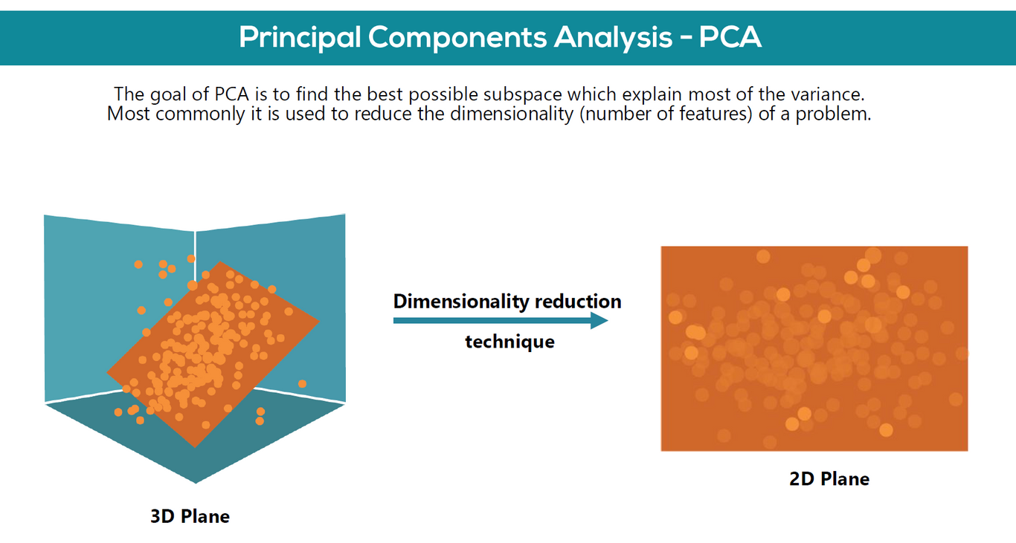
PAGE 10

Slide 11
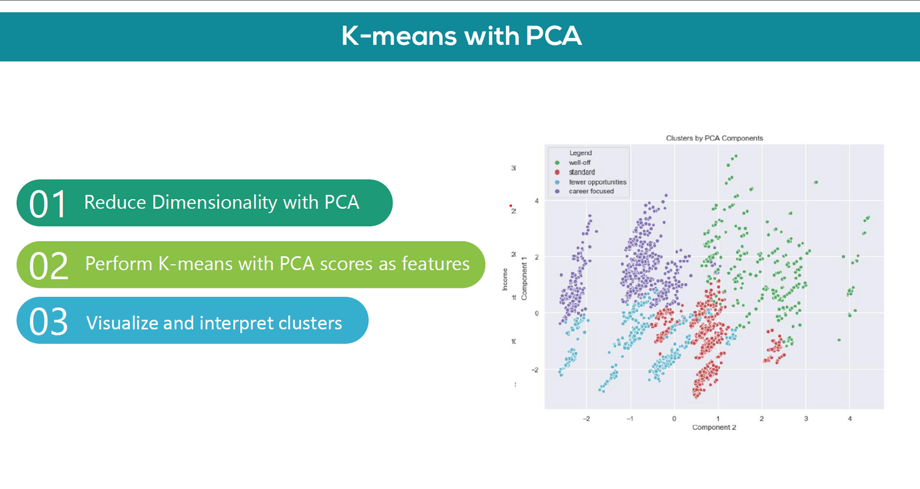
PAGE 11

Slide 12
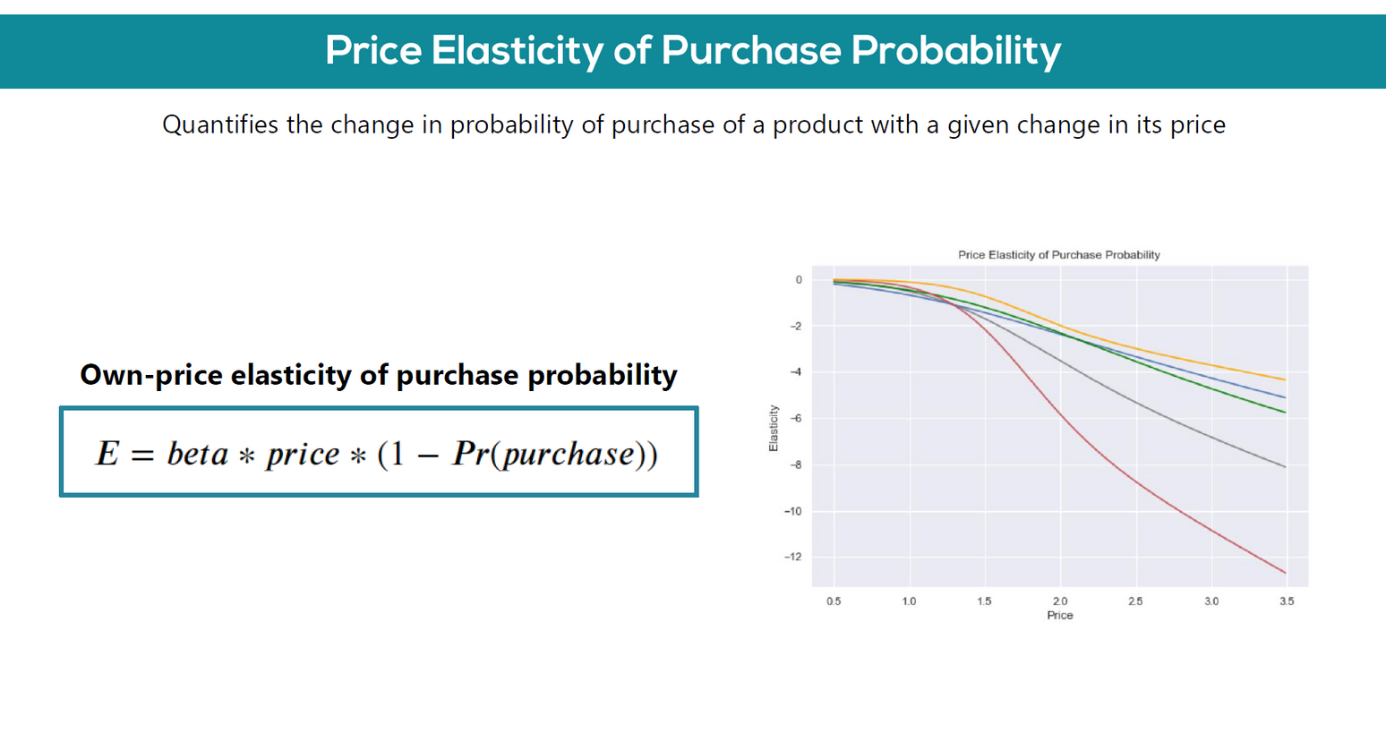
PAGE 12

Slide 13
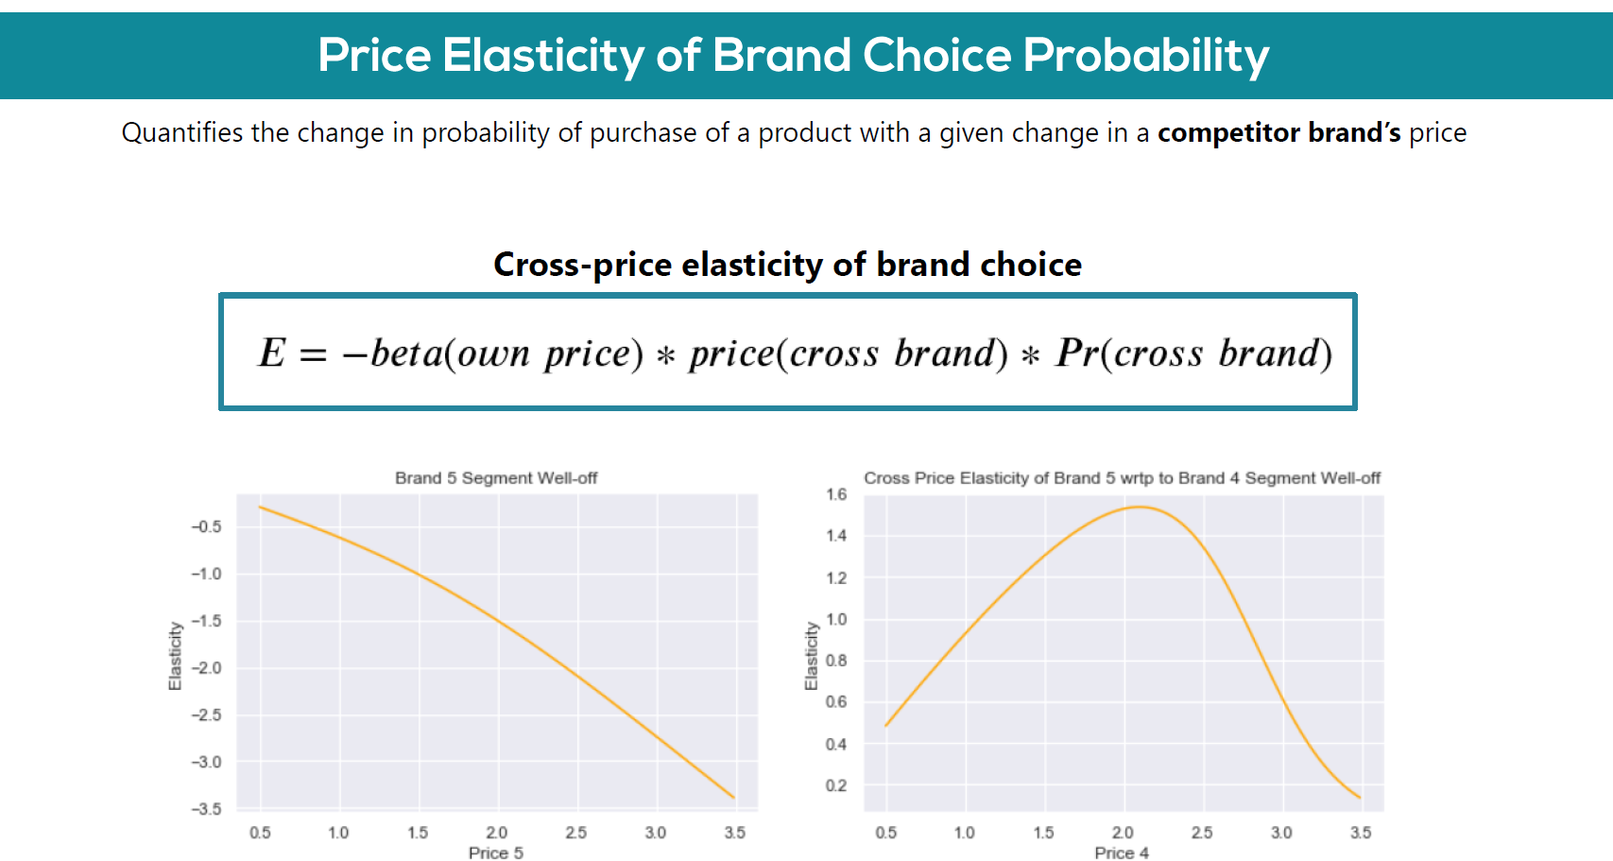
PAGE 13

Slide 14
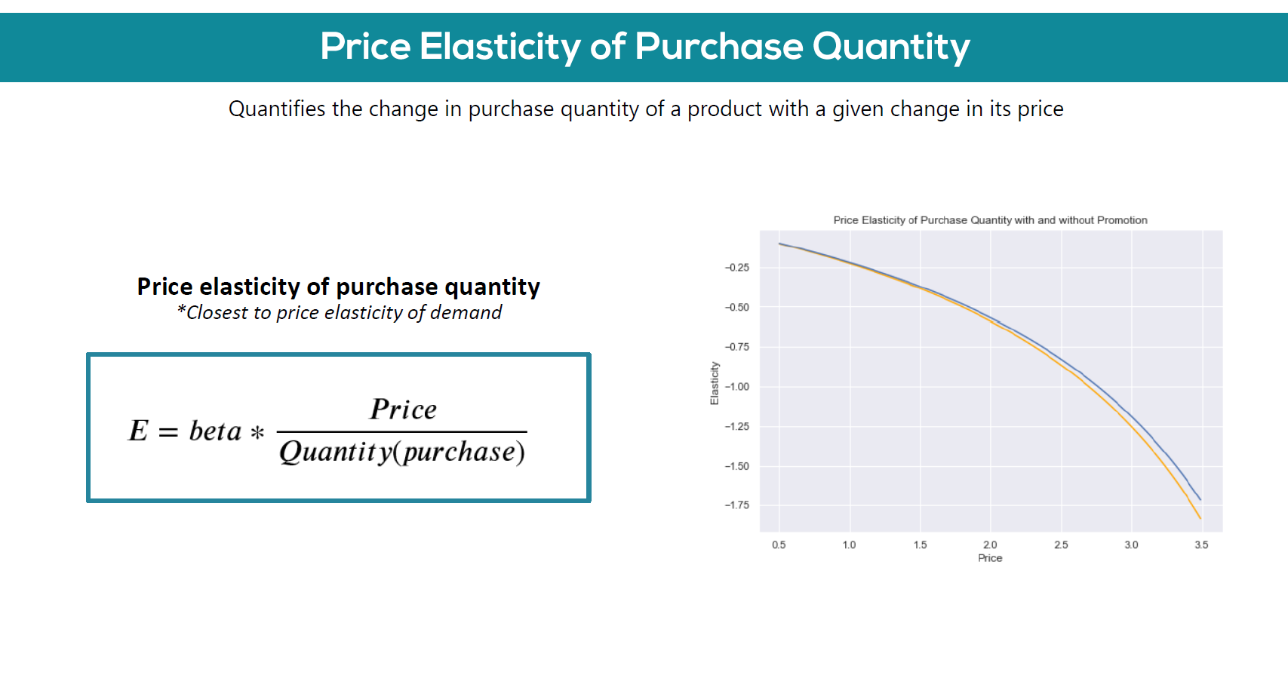
PAGE 14

Slide 15
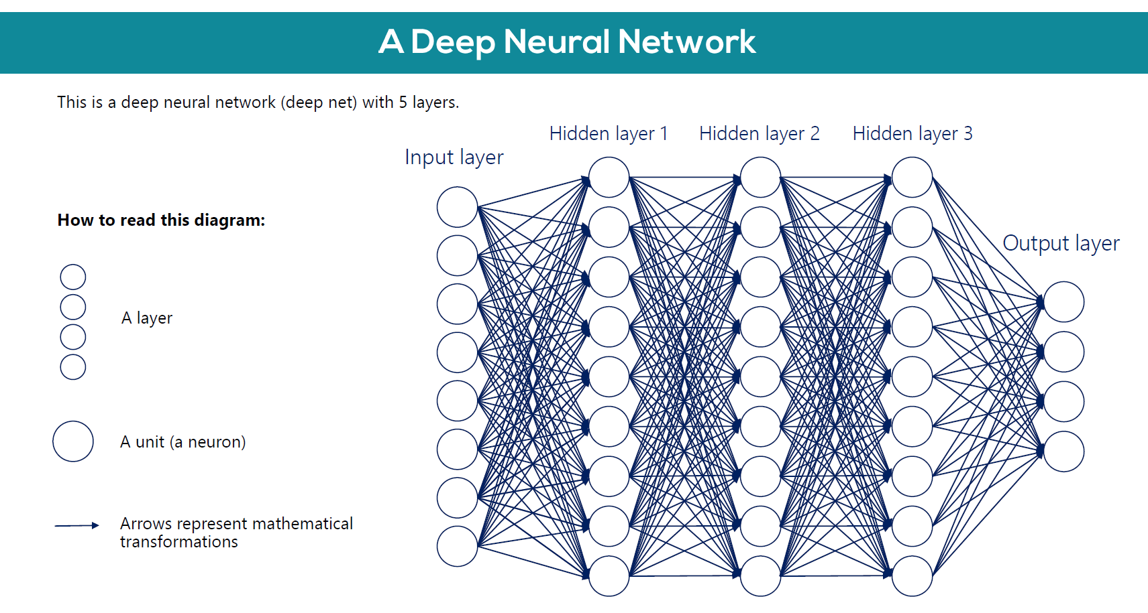
PAGE 15

Slide 16
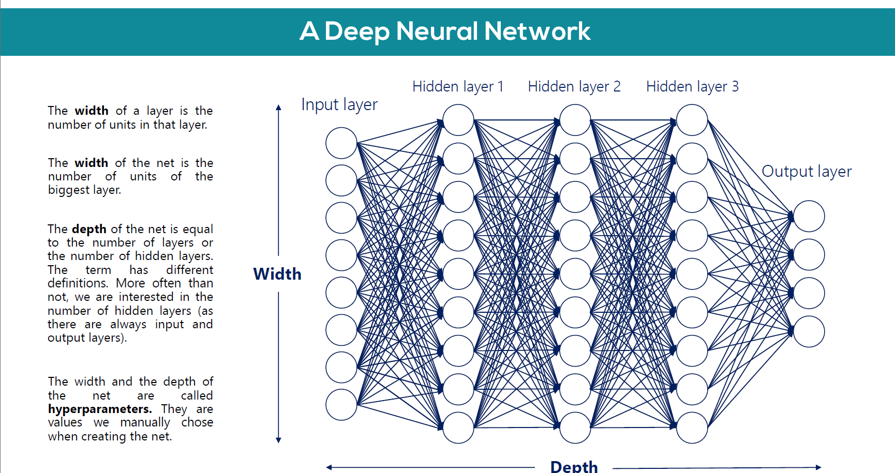
PAGE 16

Slide 17
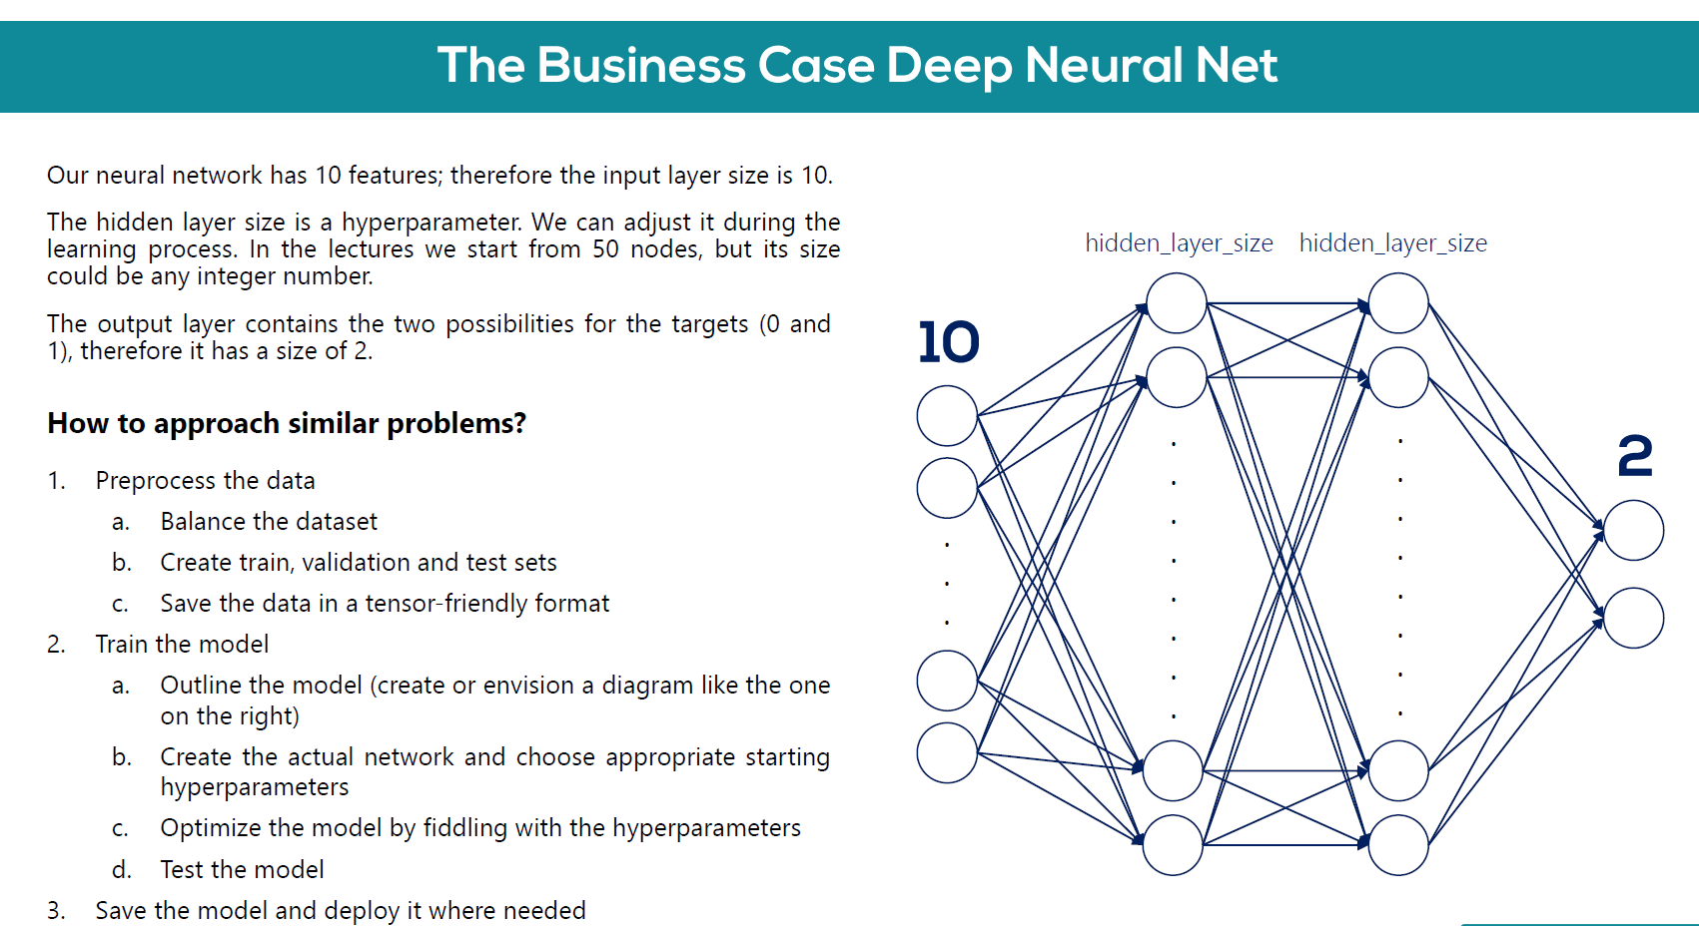
PAGE 17

